Slide 1
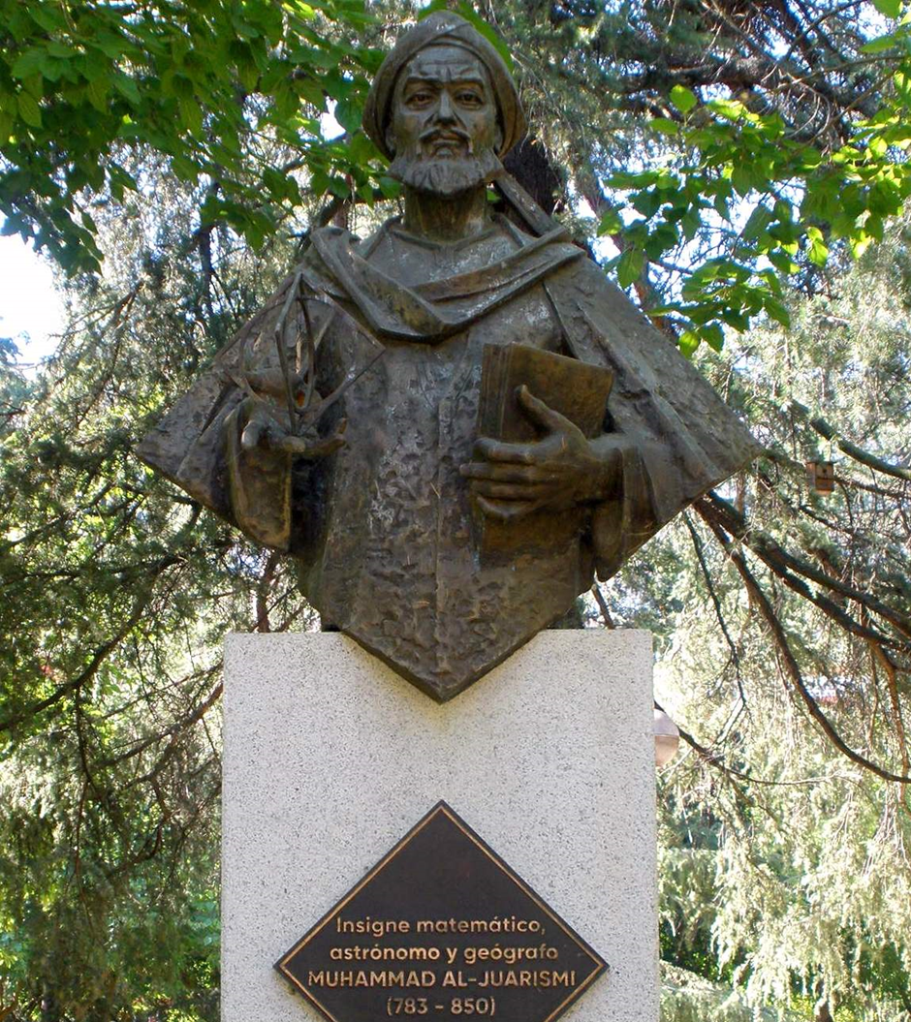
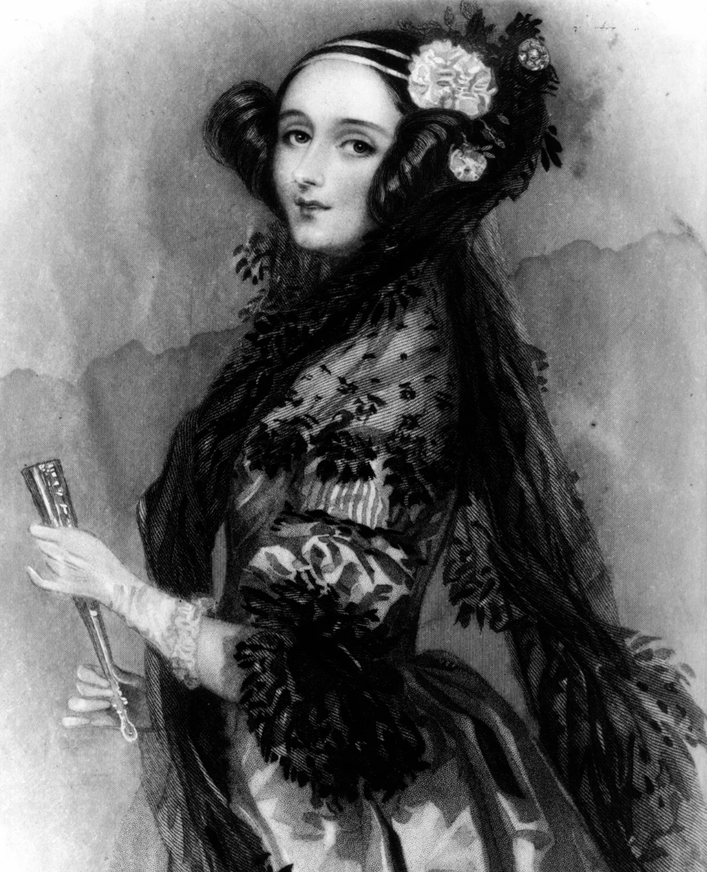
Programming with MicroBits
(With special thanks to Ada Lovelace and Muḥammad al-Khwarizmi)

Slide 2
What you’ll do to help you understand programming…
Follow a simple algorithm
Evaluate it
Explore some of our building blocks when making programs
Variables
Loops
Selection
Input
Output
Predict what some code will do
Run the code to find out
Change the code to make it better

Slide 3
Activity 1: what can you spot in the code?
Variables – these are names to hold numbers, text, or other info
Loops – if you want to do the code in the following block more than once
Selection – your program does one thing if a condition is met, and another if it isn’t
Import – you state which code (probably written by others) you want to use
Comments – these explain what the code does to make it easier to read (which is really important when you work as a team)
Input – the microbit takes in information, like a button being pressed
Output – the microbit gives out information

Slide 4
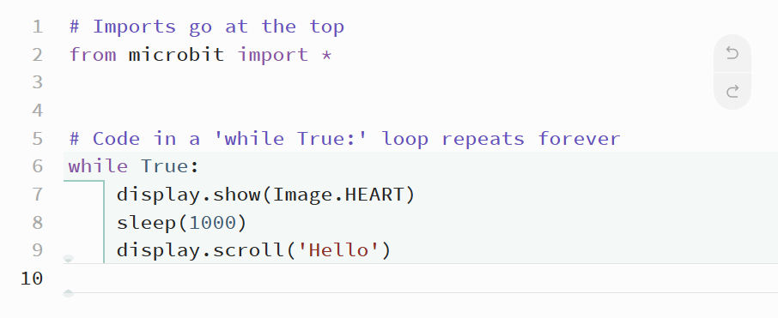

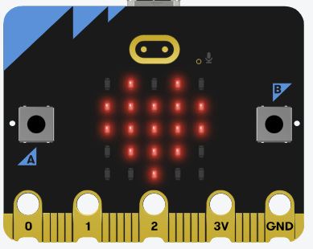
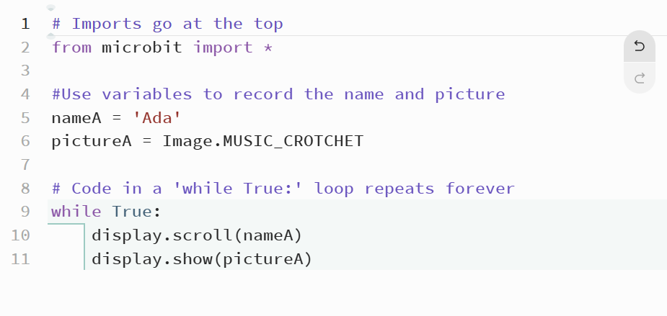

Can you find any of these in the Python code?
Comments
Loops
Input
Output
Imports
Can you predict what the code will do?

Slide 5
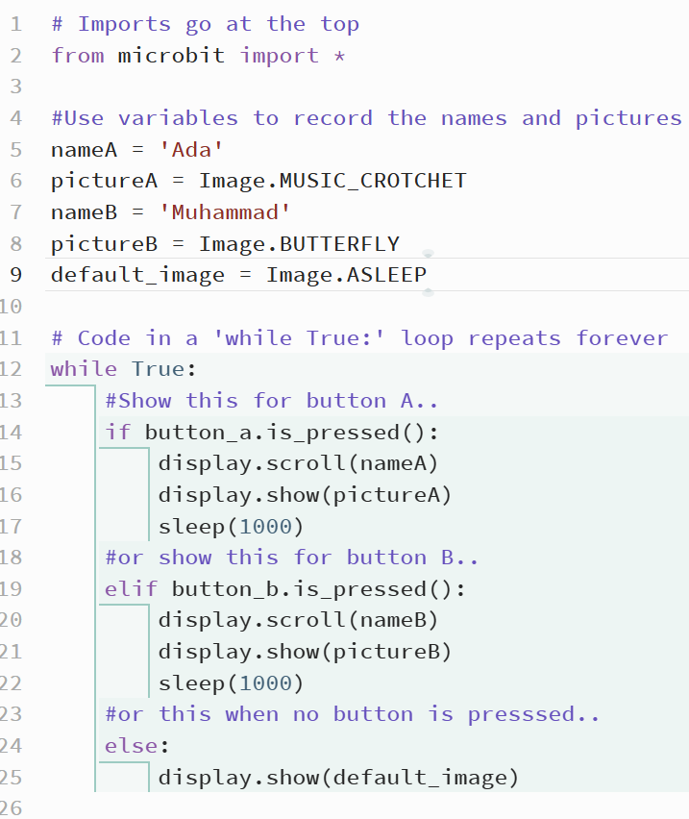
Here is a more complicated Python program…
Can you find any of these?
Comments
Loops
Input
Output
Imports
Selection
Can you predict what the code will do?

Slide 6

Try it yourself..
Type this address into the bar at the top of the screen on Edge, Safari or Chrome: Ludlowcode.github.io/queens-school/
Copy one of the programs and paste it into MicroBit (python.microbit.org/)
Run it by pressing play
Make it better by adding your own name, and changing the colour
Swap with your partner so that they can do the same

Slide 7
Quiz!
Click on the link from the main page or here: https://forms.office.com/e/CNNj8cHZcX

